Slide 1

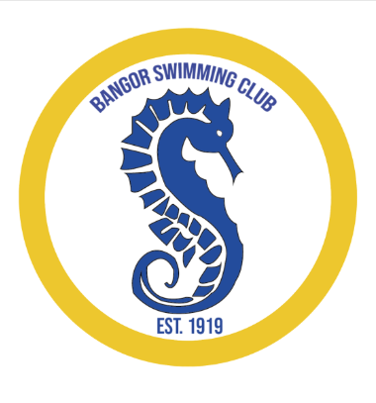

Bangor Swimming Club
Swim Competitions

Slide 2
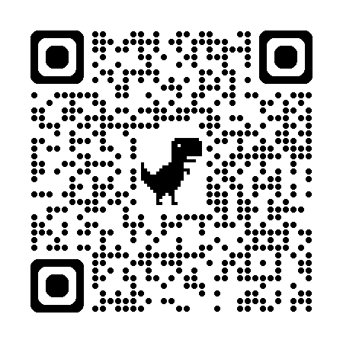
Swim Ulster Swim Competitions
Swim Ulster Competition Calendar 25/26 season
https://www.swimulster.com/wp-content/uploads/2025/09/Draft-Competition-Calendar-2025-2026-v388.xlsx-Read-Only.pdf
Swim Ulster Competition Handbook 25/26 season
https://www.swimulster.com/wp-content/uploads/2024/10/Swim-Ulster-Competition-Handbook-v4.pdf

Slide 3
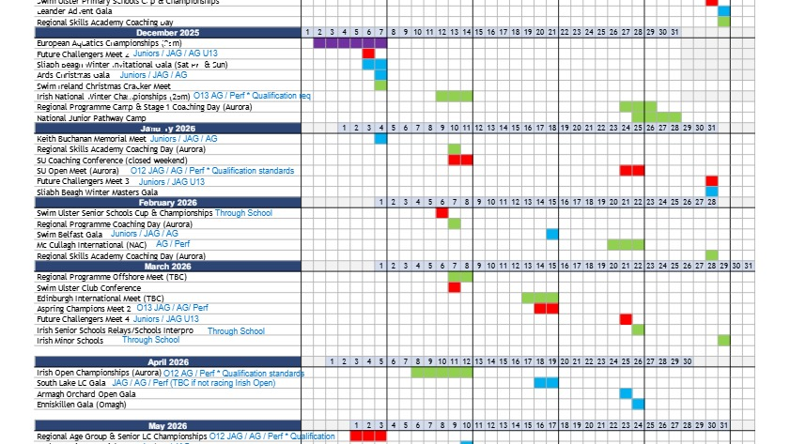
Swim Ulster Swim Competitions

Slide 4
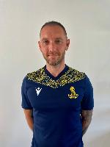
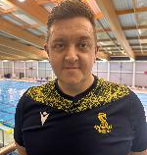
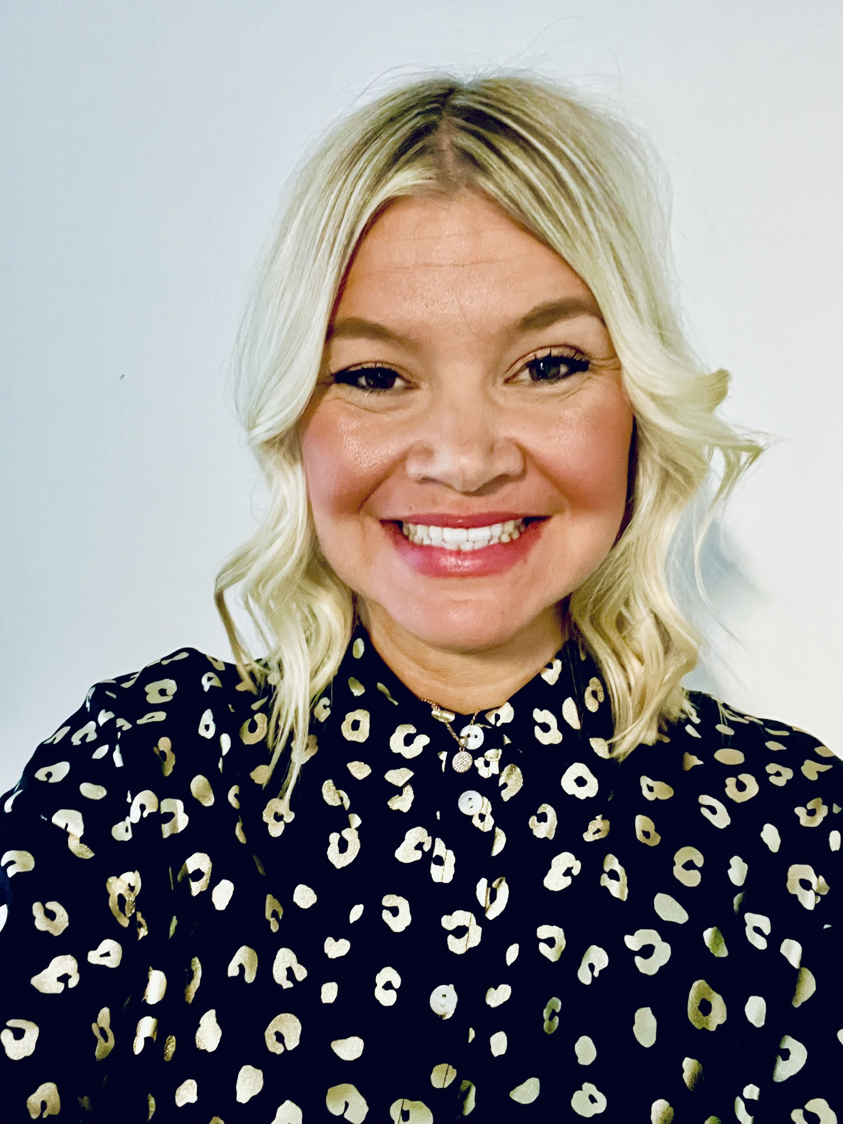
James Hand - Head Coach
Sarah Reynolds
Junior Development Lead
Richard Morrow
AG Lead Coach
BSC Coaching Team

Slide 5
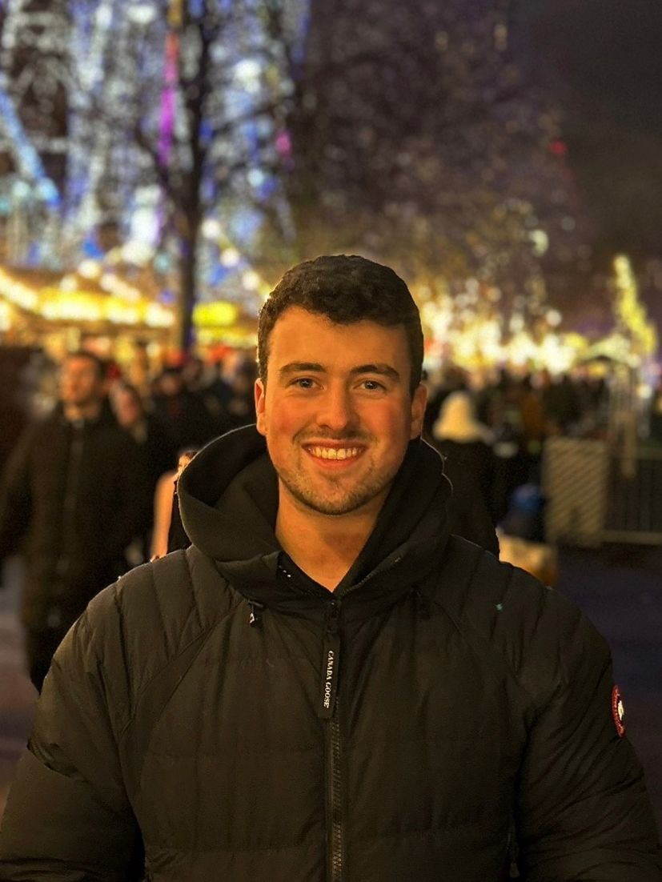
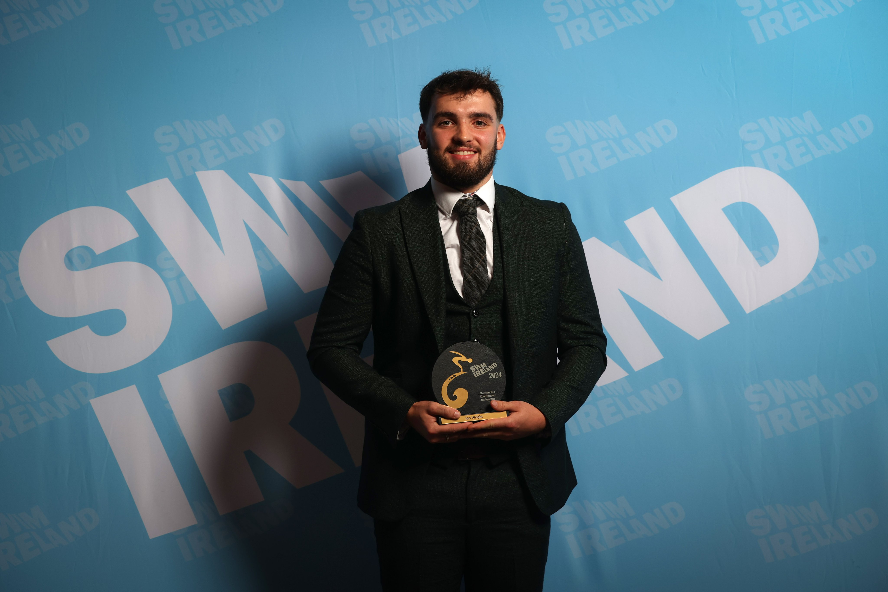
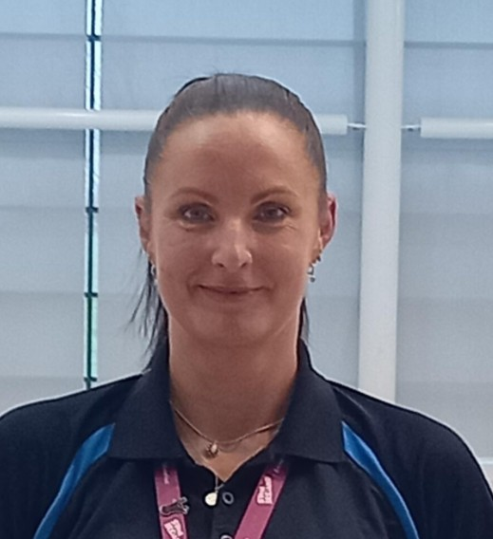
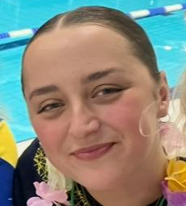
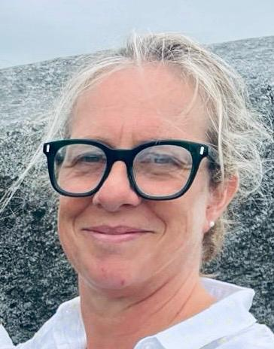
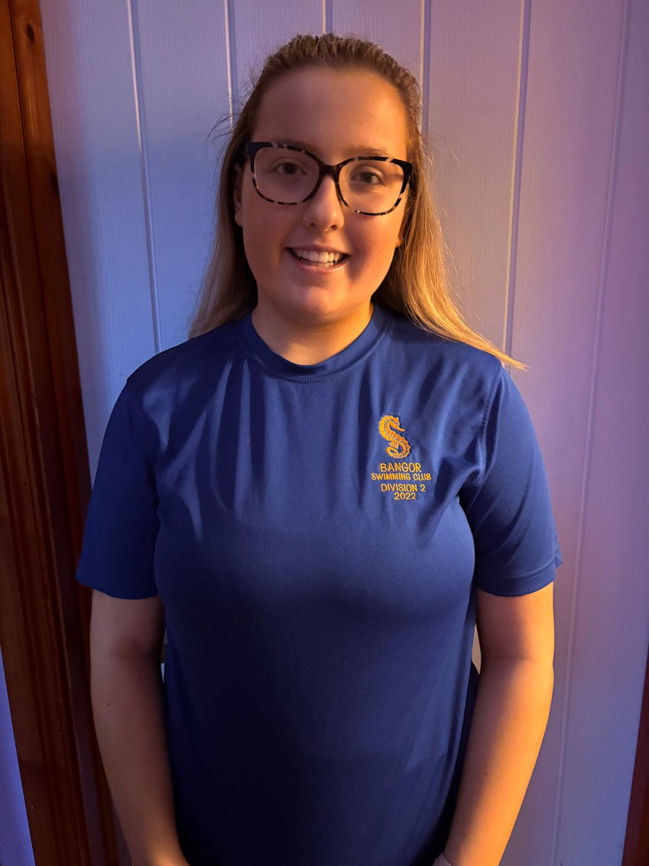
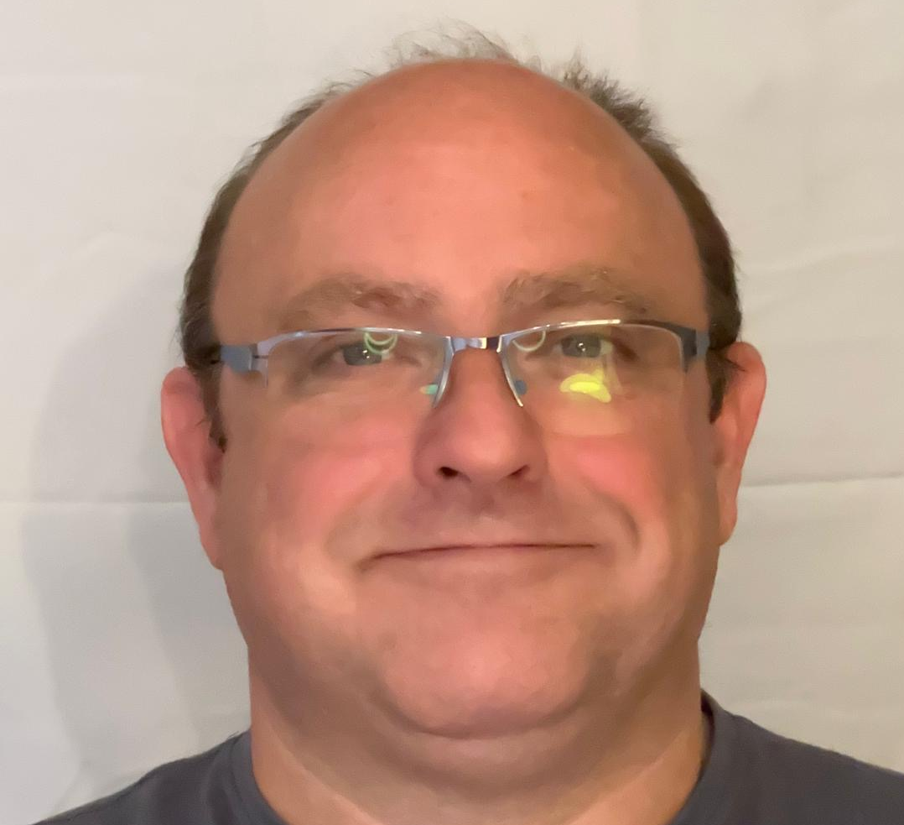
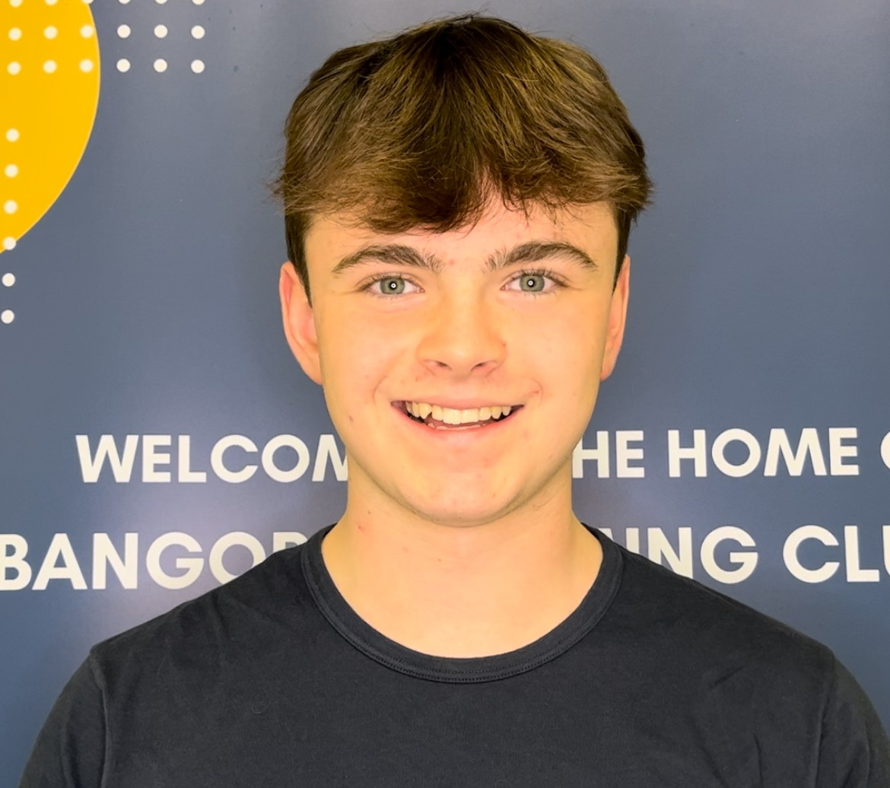
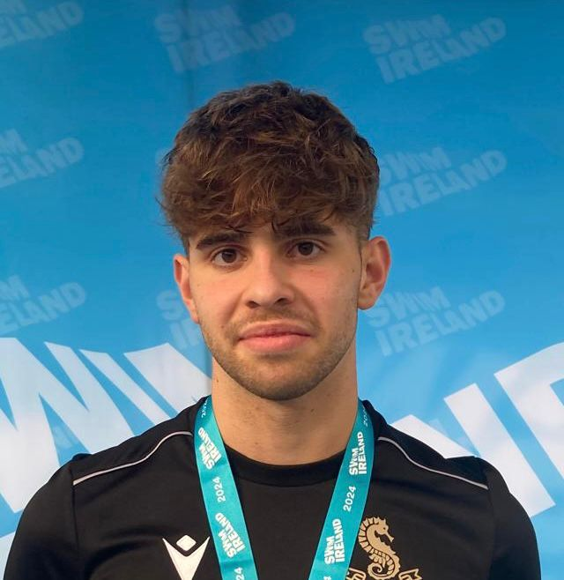
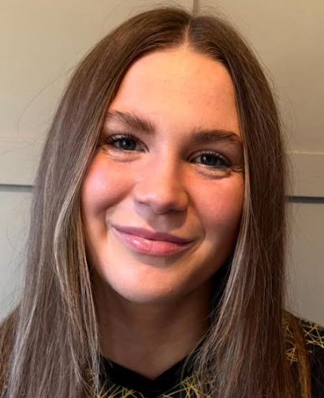
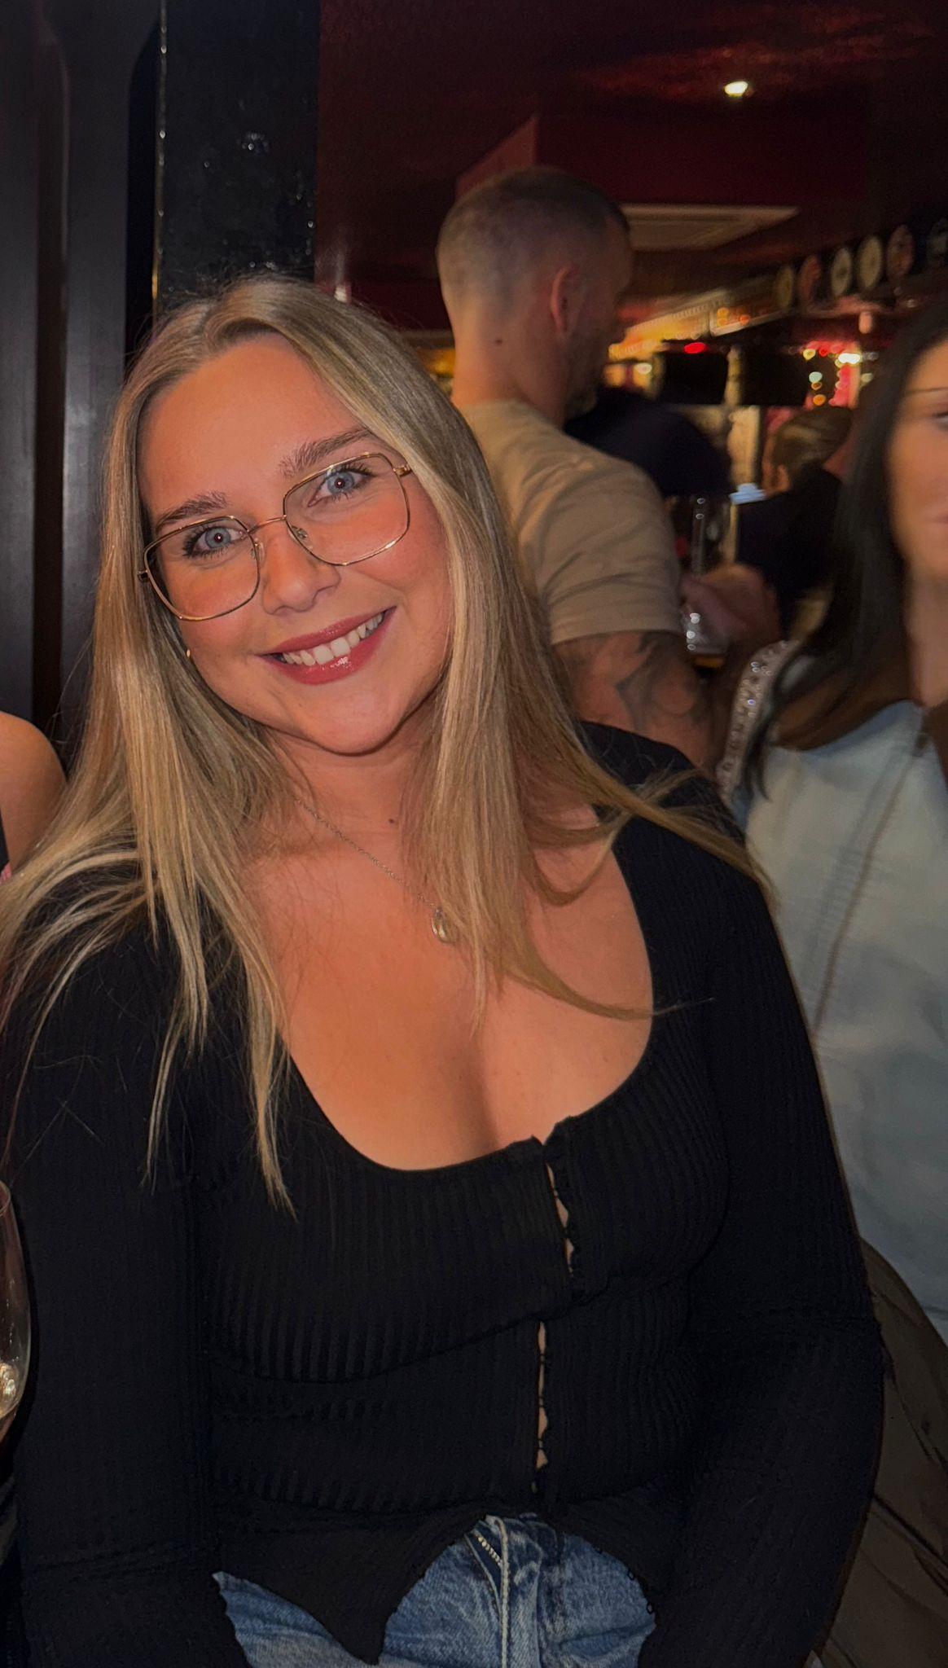
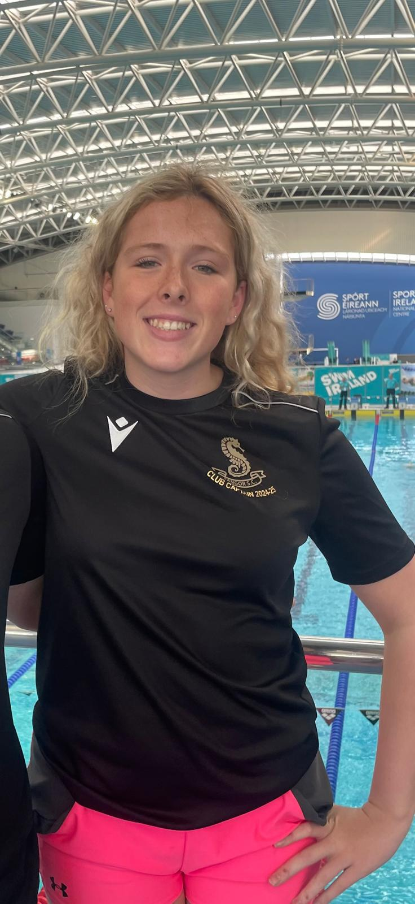
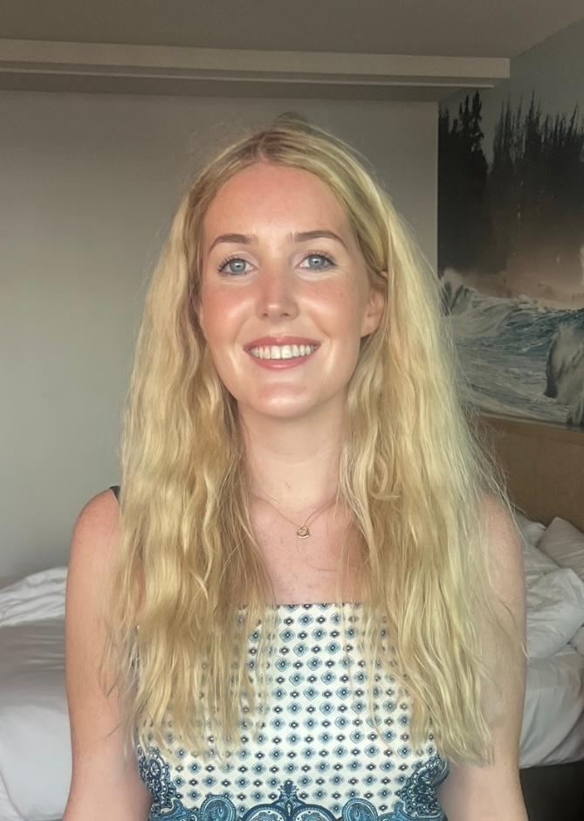
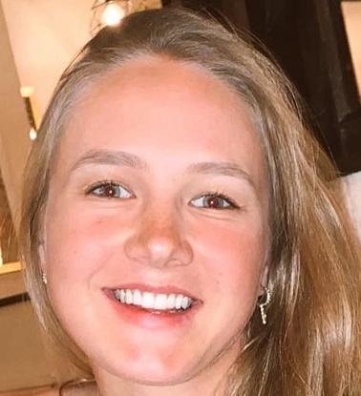
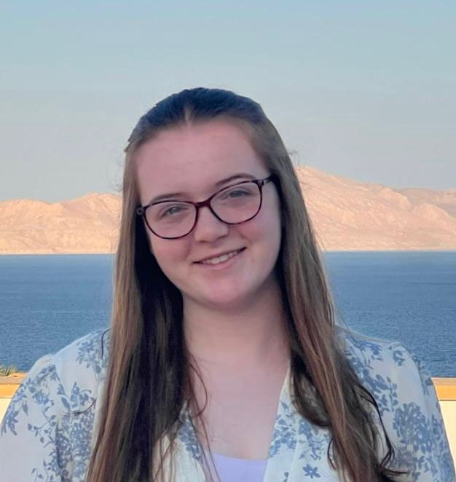
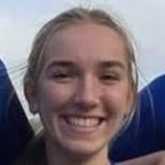
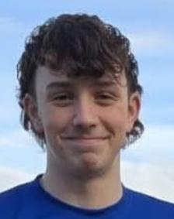
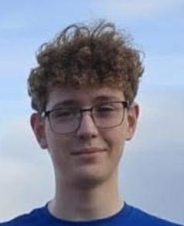
BSC Coaching Team
Mark Stoops
Samuel Wright
Lezah McMullan
Anna Park
Grace McLaughlin
Jasmine Savage
Chris Stewart
Jake Lynas
Austin Williams
Eva McCann
Eve McCutcheon
Naomi Smyth
Claire Gillen
Jemma Speers
Chloe Lyons
Eva Hand
Eddie Kirwan
Matthew Hooker

Slide 6
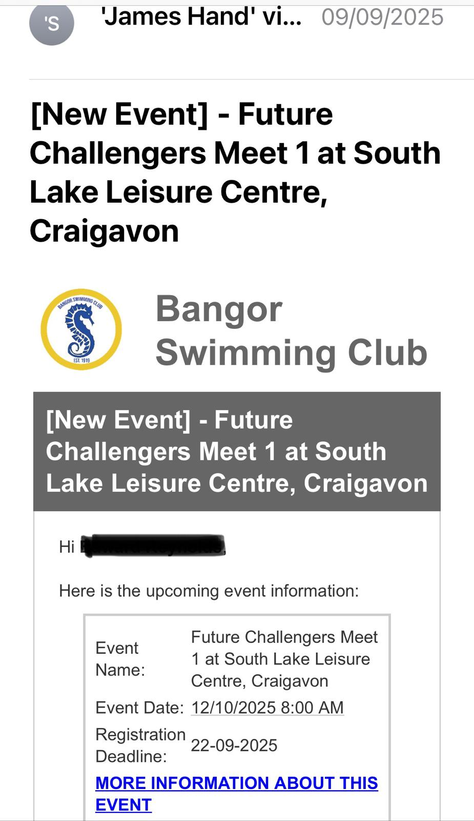
Step 1:
You will receive an email from James Hand
Click on and read the ‘more information’ link
Your swimmer’s name here

Slide 7
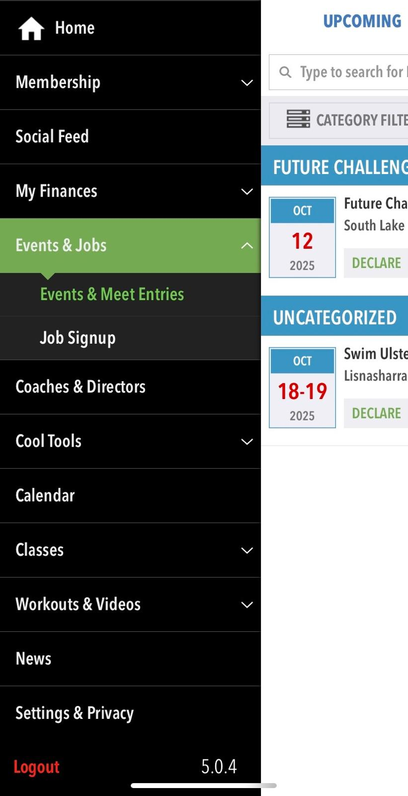
You can also go in via the Sports Engine App
Click on and read the ‘more information’ link

Slide 8
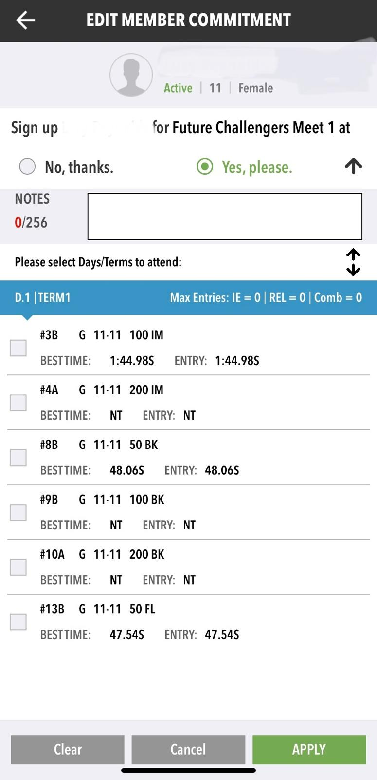

Step 2:
Accepting or Declining the invite
Yes or No
Note section
Click on the box
Apply
Your swimmer’s name here

Slide 9
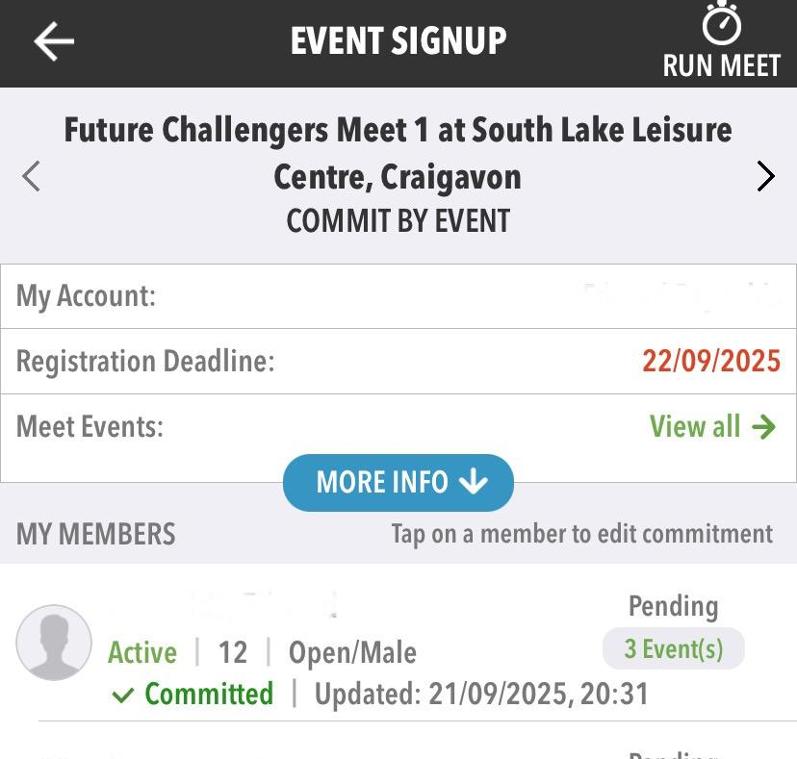
Step 3:
Commit by event Sign Up
Pending events until Coach approves
Your swimmer’s name here

Slide 10
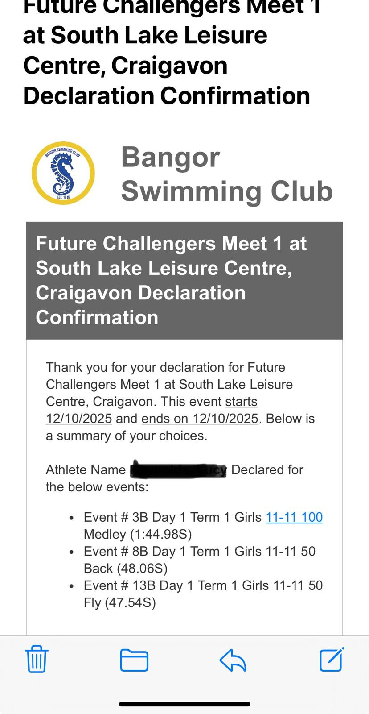
Step 4:
Email confirmation of what you have declared
Your swimmer’s name here
Events you have entered here

Slide 11


Step 5:
The PDF with accepted entries will be sent to your squad’s WhatsApp communication by your Team Manager
Please check and read your swimmers’ entries. If you see anything you wish to change, please email either: coachsarah@bangorsc.co.uk or
Jameshand1980@me.com

Slide 12
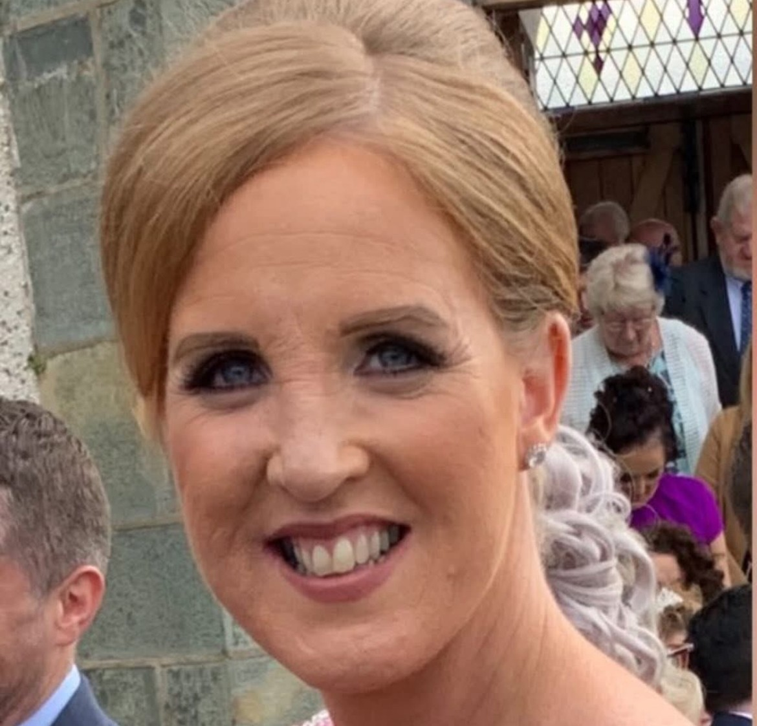
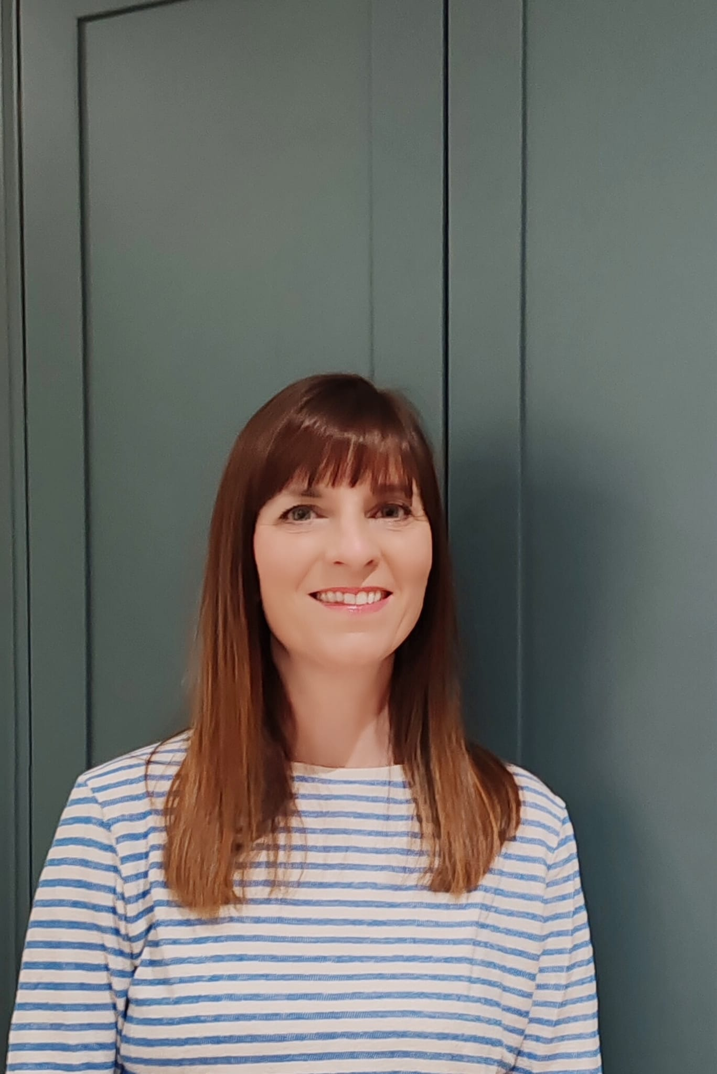
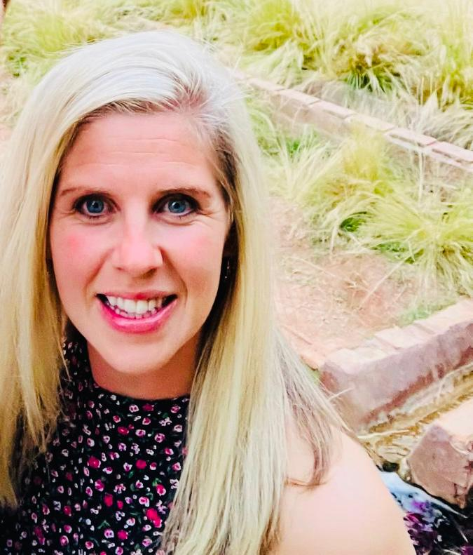
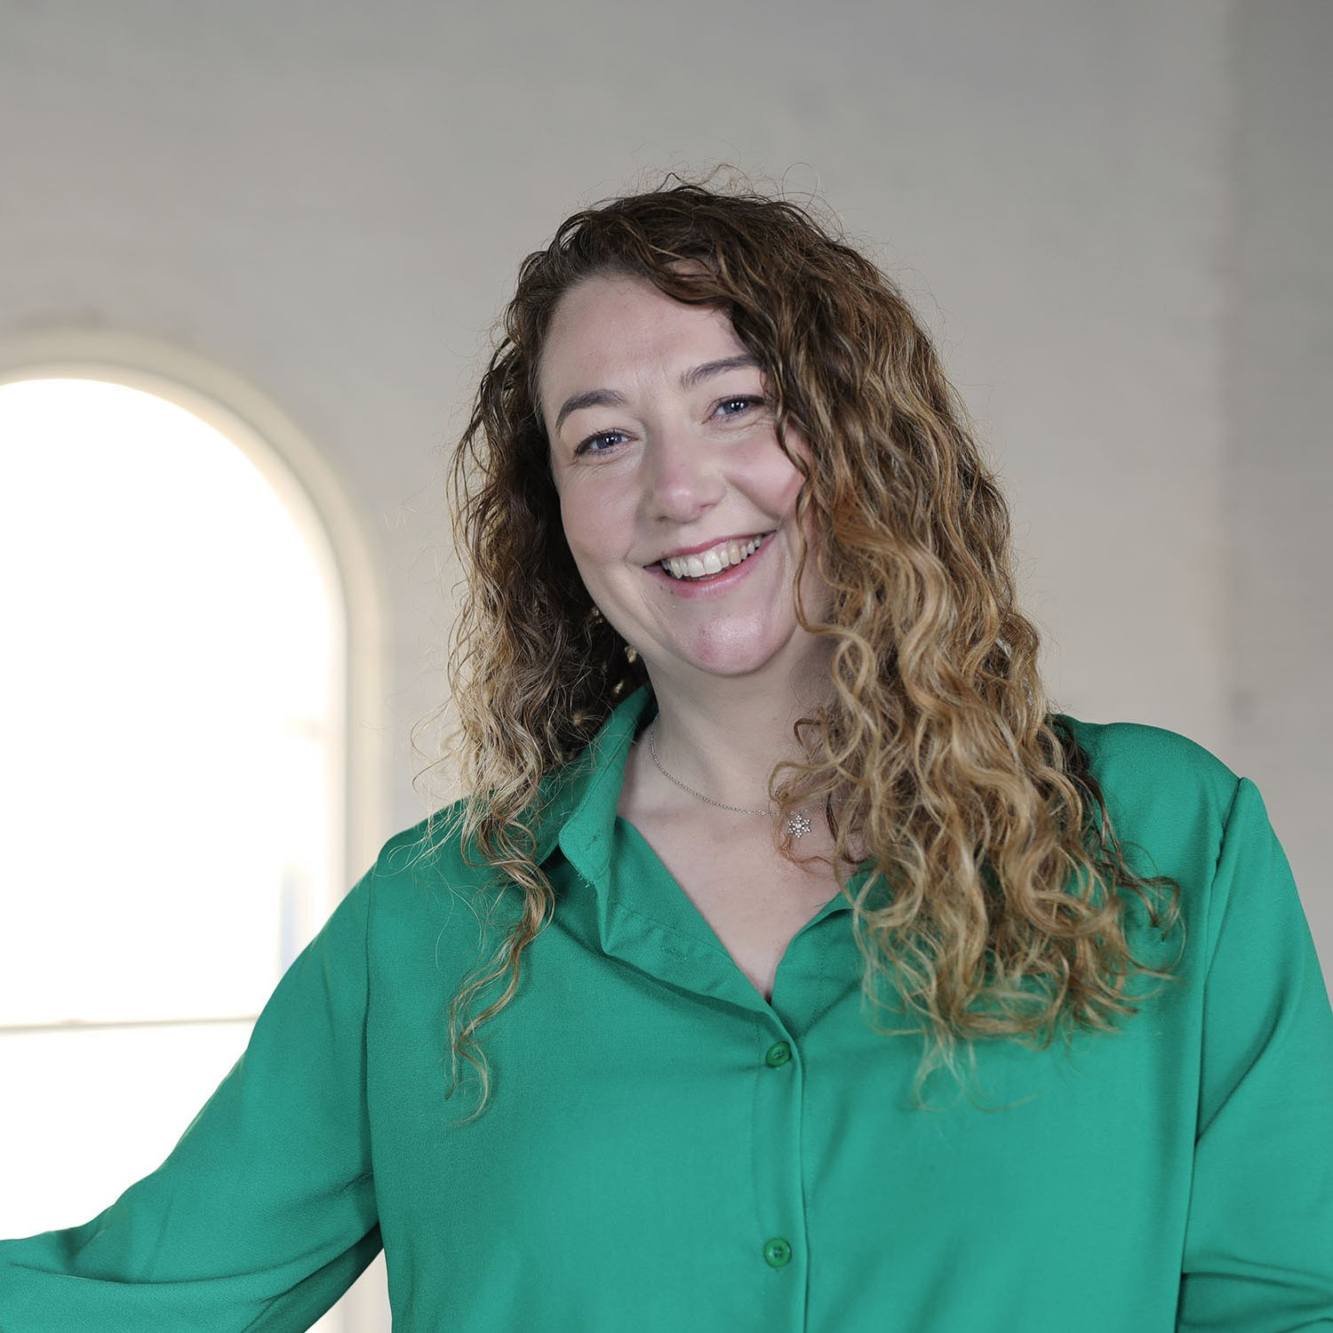
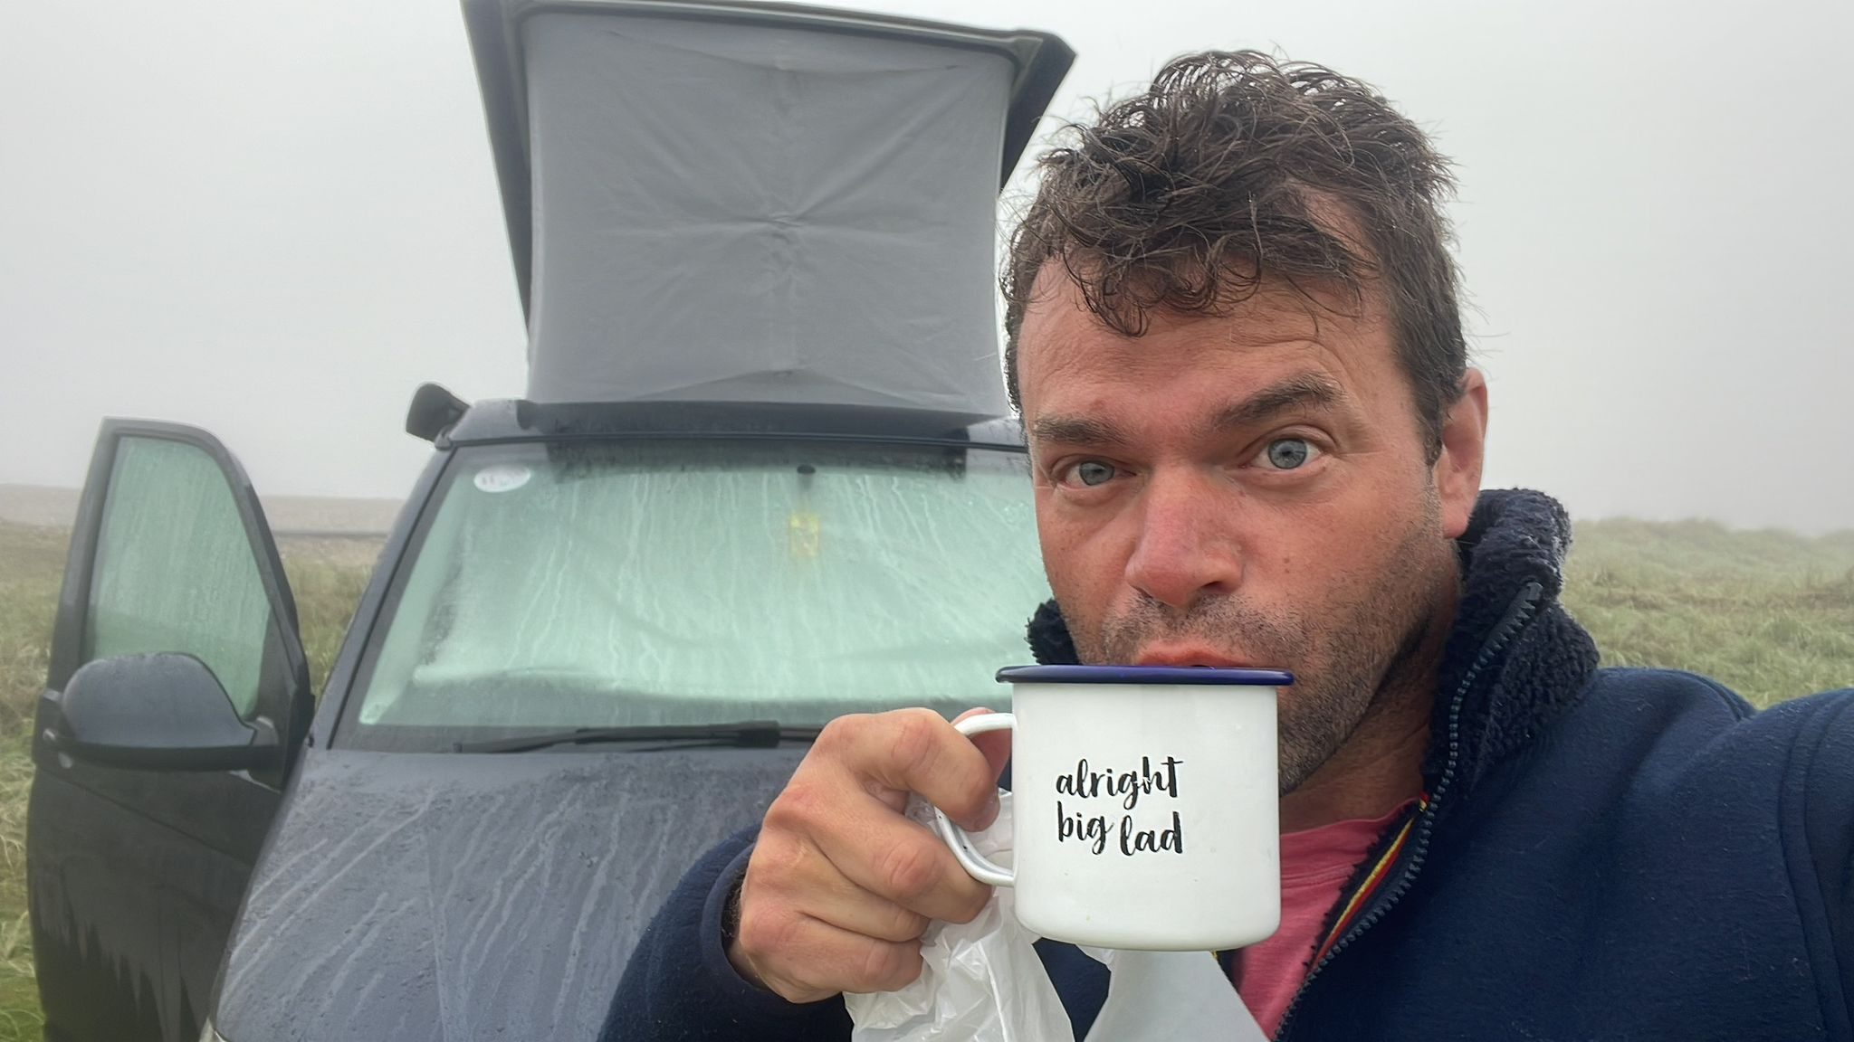
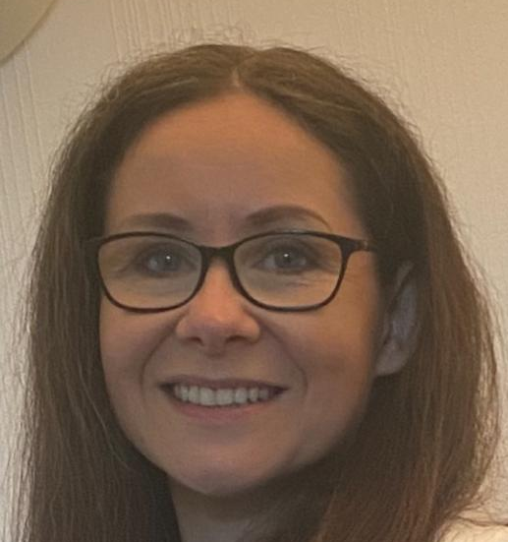
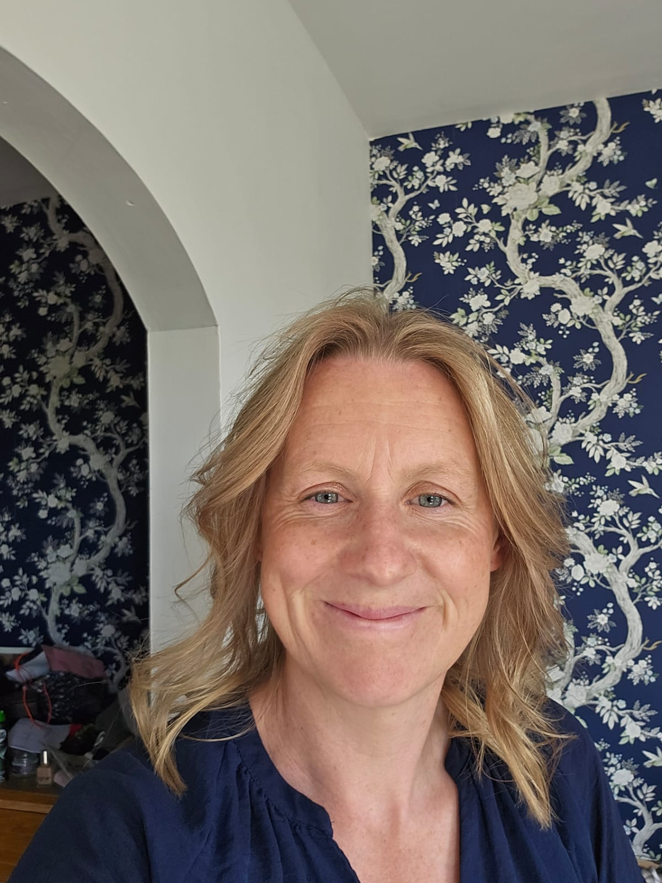
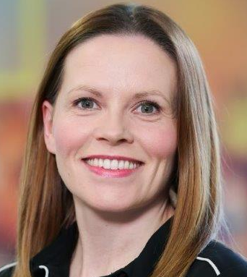
Squad | Name of TM
Junior Entry (JE) | Jennifer Gill
Junior 4 (J4) | Iain McCarthy
Junior 3 (J3) | Katie Legg
Junior 2 (J2) | Jennifer Gill
Junior 1 (J1) | Ildiko Hamilton
Junior Age Group (JAG) | Jenny Moore
Age Group | Esther Coulter
Training Squad | Caroline Kirwan
Performance | Carol Boal
BSC Team Managers (TM)

Slide 13
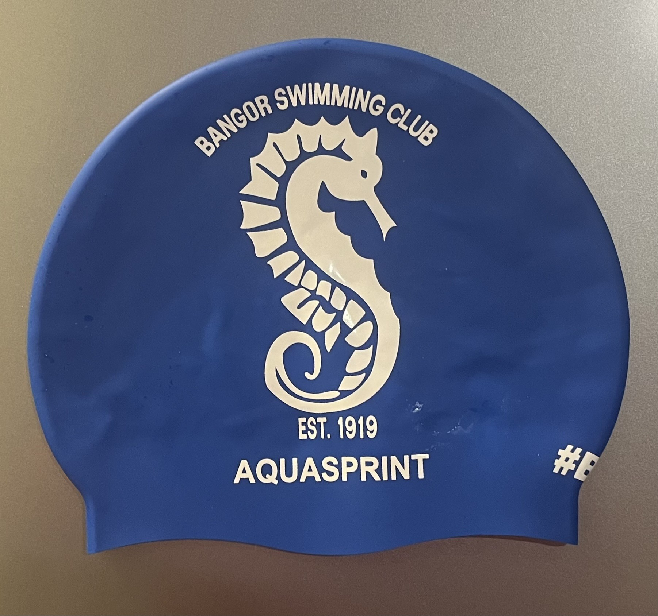
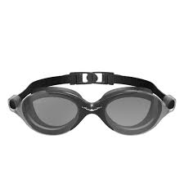
Swim Equipment for Race Day
X 2 pair of swim googles (a spare is always useful)
Small bag only for the poolside
BSC hat
Including:
Wearing a BSC t-shirt on poolside
Wearing flip flips/appropriate poolside shoes
Water
Healthy Snacks
Towel

Slide 14
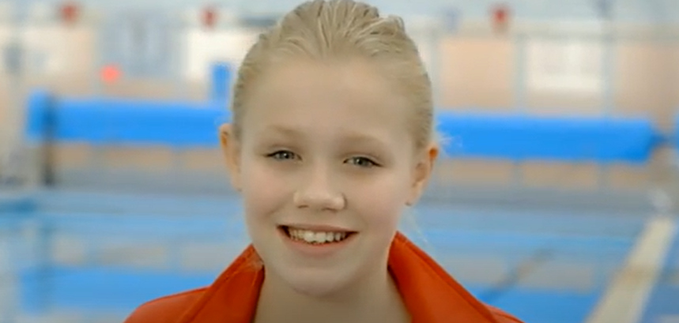

Etiquette
My Magic Sports Kit - YouTube
https://www.youtube.com/watch?v=C2uH9Dle8mQ

Slide 15
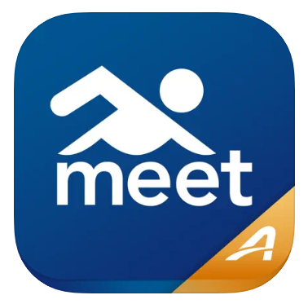
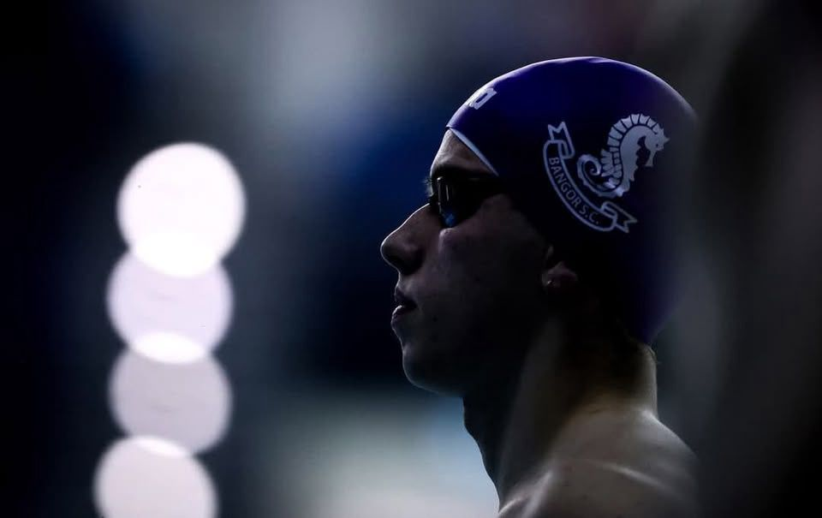
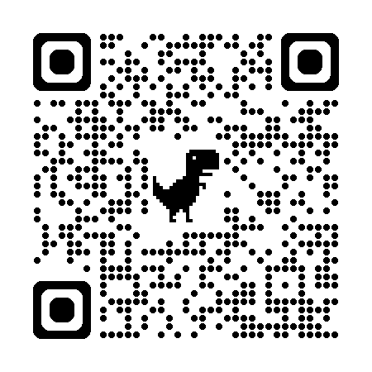
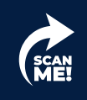
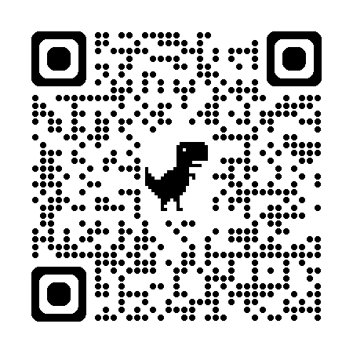
Meet Mobile App
Accessing Results
iPhone users:
Android users:

Slide 16
Thank You
Enjoy the galas!
Swim Competitions

